Slide 1
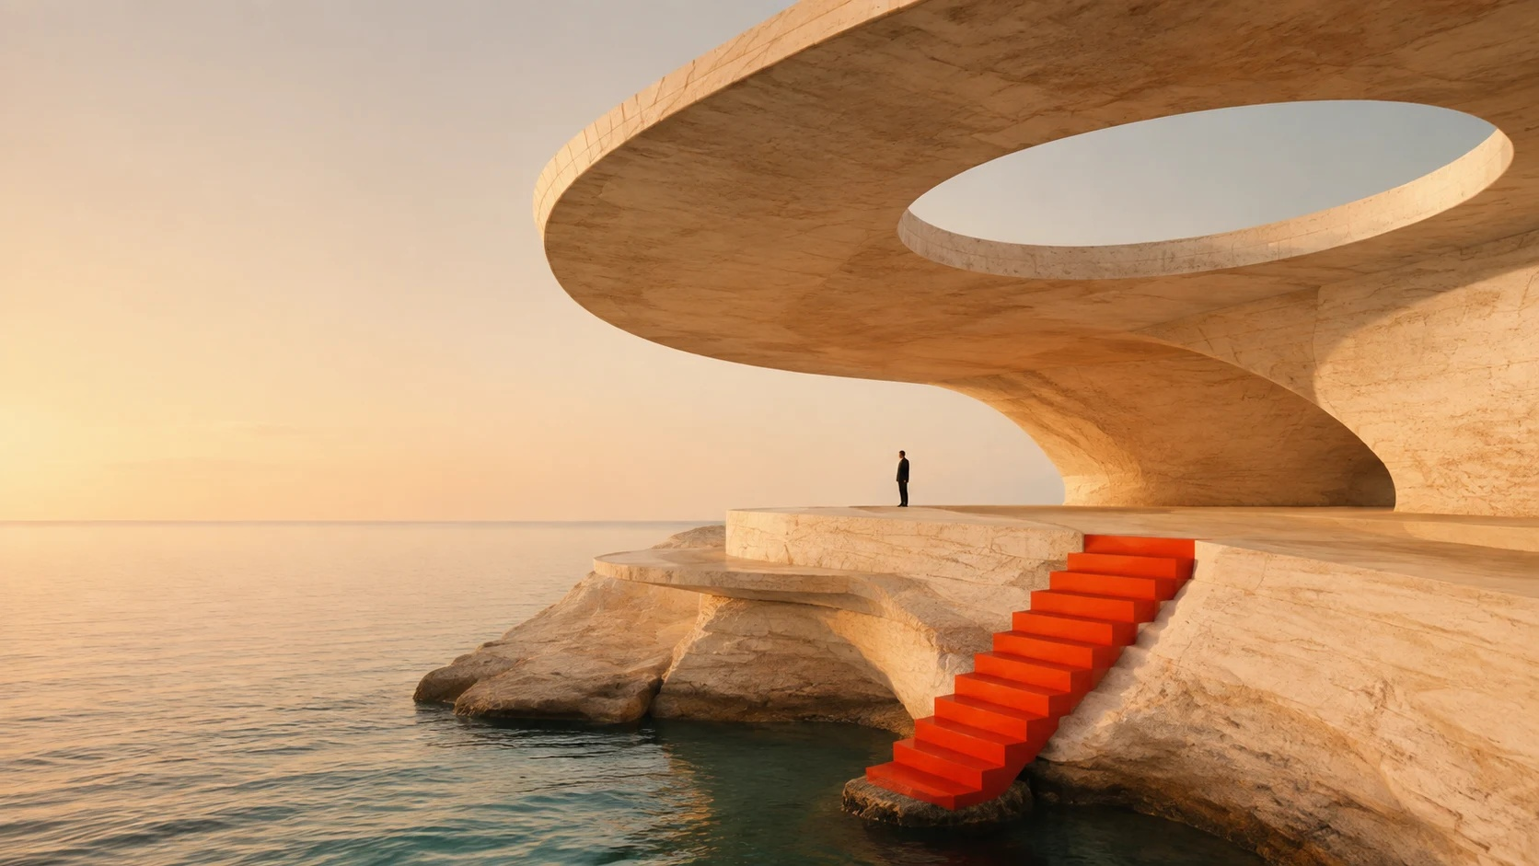
STUDIO / AFTERLIGHT
After
light.
光的形状
An architecture concept at the edge
of land, light and water.
01 / CONCEPT & ART DIRECTION

Slide 2
STUDIO / AFTERLIGHT
02 / 06
Leave room
for the unexpected.
空间不必填满，
想象才有余地。
A quiet retreat shaped by a horizon, a circle, and the path between them. Architecture becomes a frame for what is already there.
ORIGINAL DESIGN DEMONSTRATION / GNJ AI

Slide 3
STUDIO / AFTERLIGHT
03 / 06
Three gestures.
One clear idea.
01
02
03
Frame / 取景
Trace / 路径
Pause / 留白
A circular opening holds the sky. Every viewpoint becomes a deliberate composition.
A vermilion stair draws one clear line between the built world and the water.
Unprogrammed space invites people to slow down, look out, and stay a little longer.
ORIGINAL DESIGN DEMONSTRATION / GNJ AI

Slide 4
STUDIO / AFTERLIGHT
04 / 06
Warm stone. Deep water.
A spark.
砂岩的温度、海水的深度，再加一点意外。
TRAVERTINE
#E7D5B9
CHALK
#F3EEE2
SEA GLASS
#658479
VERMILION
#DF4B27
ORIGINAL DESIGN DEMONSTRATION / GNJ AI

Slide 5
STUDIO / AFTERLIGHT
05 / 06
A day, in three acts.
AM
NOON
PM
Arrive / 抵达
Explore / 探索
Stay / 停留
Low light reveals the texture of the stone. A narrow path opens to the horizon.
The oculus moves a circle of light across the floor. Shade creates another room.
As the stone turns gold, the steps lead toward the water. The landscape takes over.
ORIGINAL DESIGN DEMONSTRATION / GNJ AI

Slide 6
STUDIO / AFTERLIGHT
06 / 06
Good ideas
deserve form.
让好想法，有好作品。
An original demonstration by GNJ AI.
Editable text, shapes and layouts.
Original AI-generated architectural concept image.
ORIGINAL DESIGN DEMONSTRATION / GNJ AI

